Slide 1



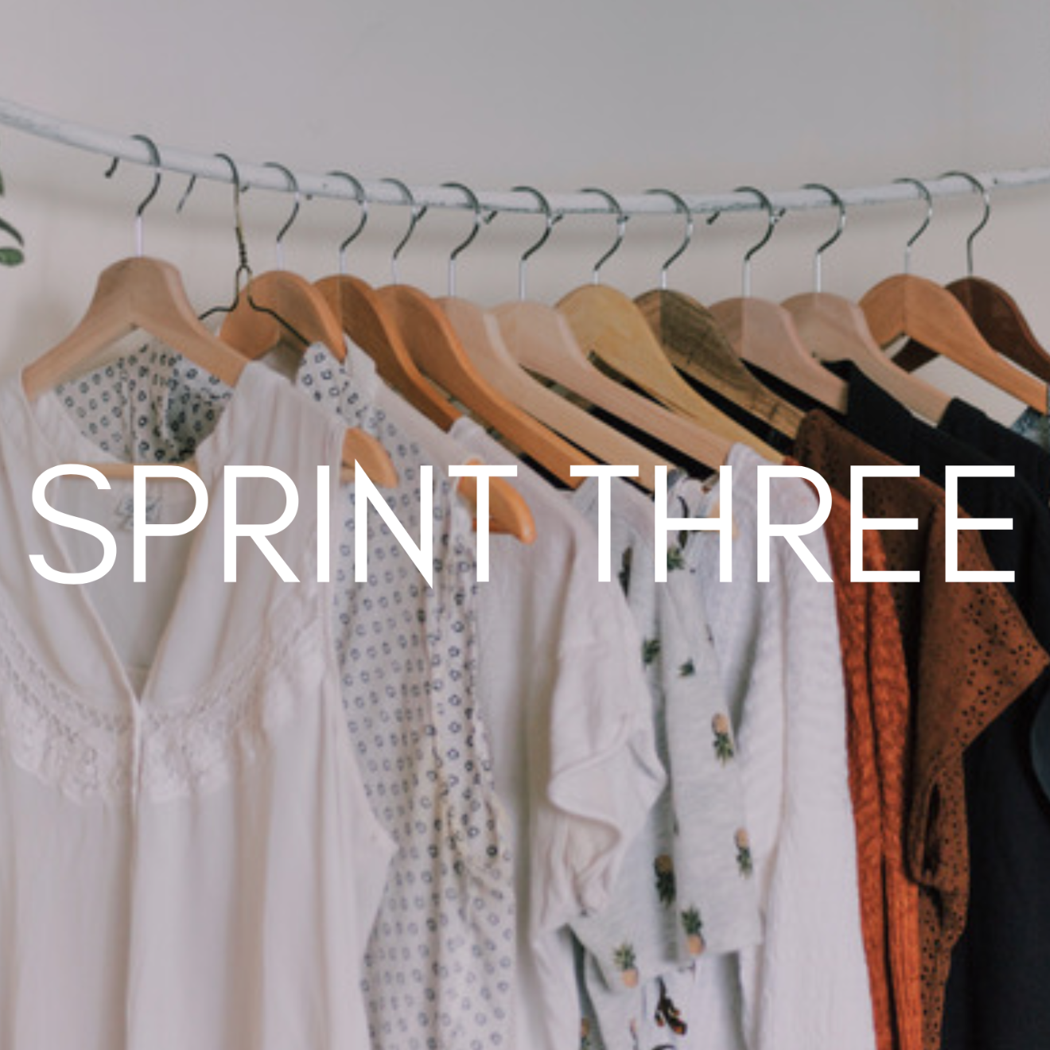

Slide 2

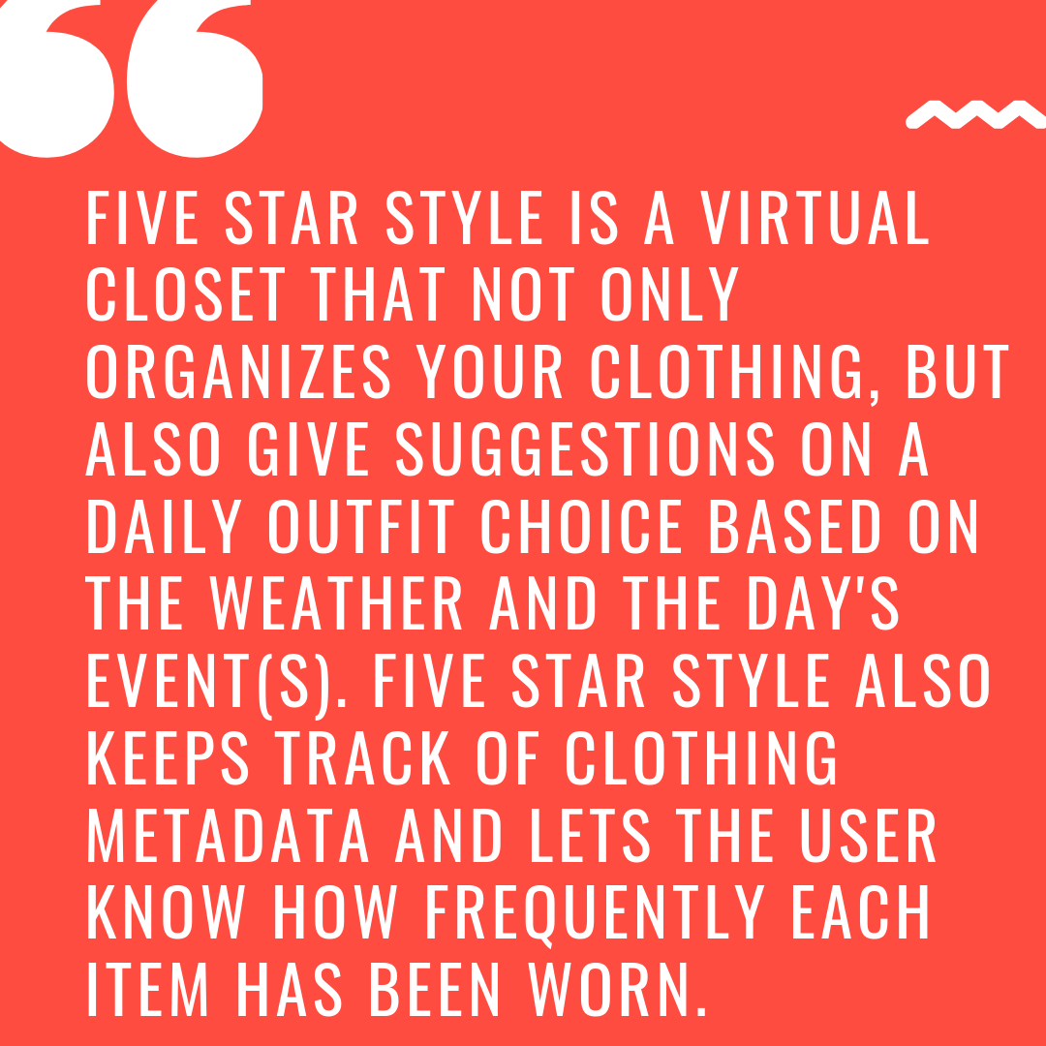

Slide 3

Completed all of Our Original goals set at the beginning
Worked Well as a Team
Communication
Sprint Meetings
Work Distribution
Integrated Numerous APIs
Time Management
Photo Analyzer
User Interface of the Application

Slide 4
Sprint Backlog
STORY
Update Closet Buttons
Item Detail Page
Query Date for Overview Pie charts
Choose My Outfit
Change Password Button on Settings Page
Create App Icon
Image Details Page
Video
Updates to Website
Delete Item
J-unit Testing
ESTIMATED TIME
2 hours
4 hours
4 hours
8 hours
1 hour
1 hour
3 hours
3 hours
2 hours
1 hour
2 hours
PRIORITY
4
2
1
1
5
3
2
1
1
2
1

Slide 5

Test that the Google Cloud Api is setting the labels correctly
Test that the reverse geocoding is returning the right address for the current location
Test that the email and password a user is using to register are valid

Slide 6
Reflections
Challenges faced
Finished All of Our Original goals for the Application
Website
Continued to Work Well Together
Video
j-UNIT Testing
Images on Pages
Pie Charts
Firestore
Choose My Outfit page

